Slide 1

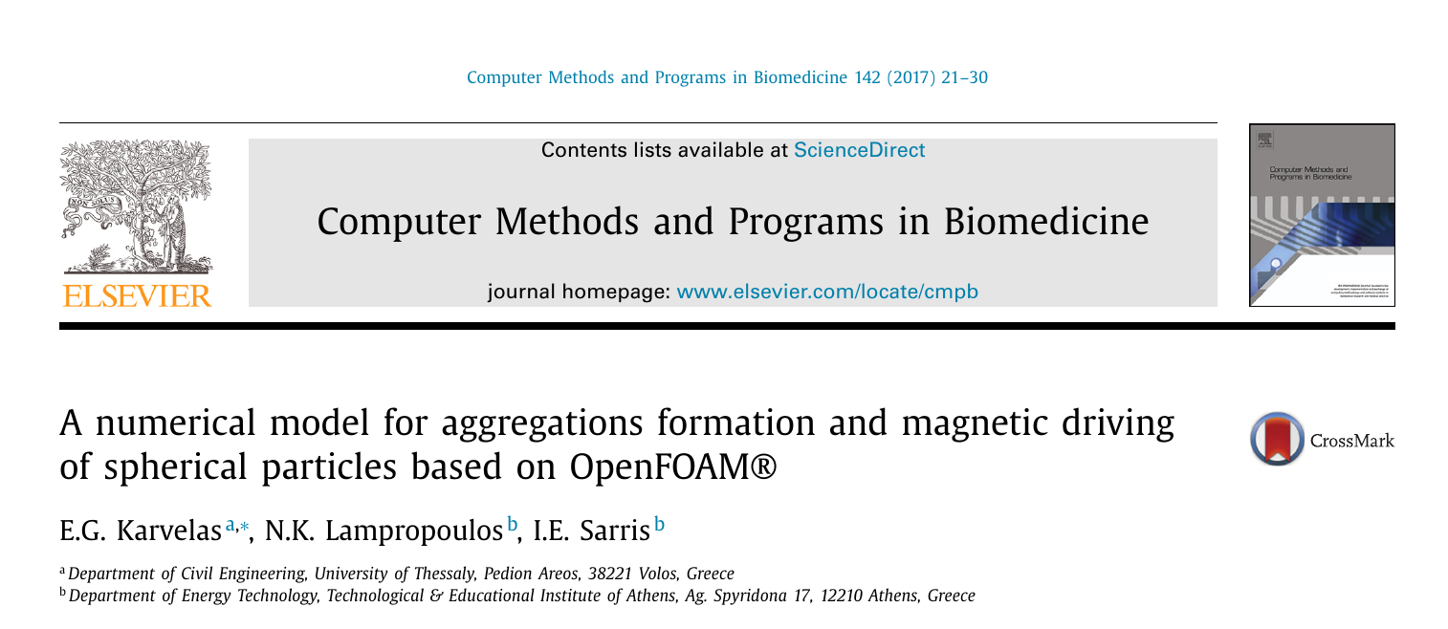
Paper Review
CHENGXI YAO
Reason: to explore CFD with OpenFOAM

Slide 2

Paper Review
Contents
1
Introduction
2
Numerical model
3
Case description
4
Result& discussion
5
Conclusion& references

Slide 3
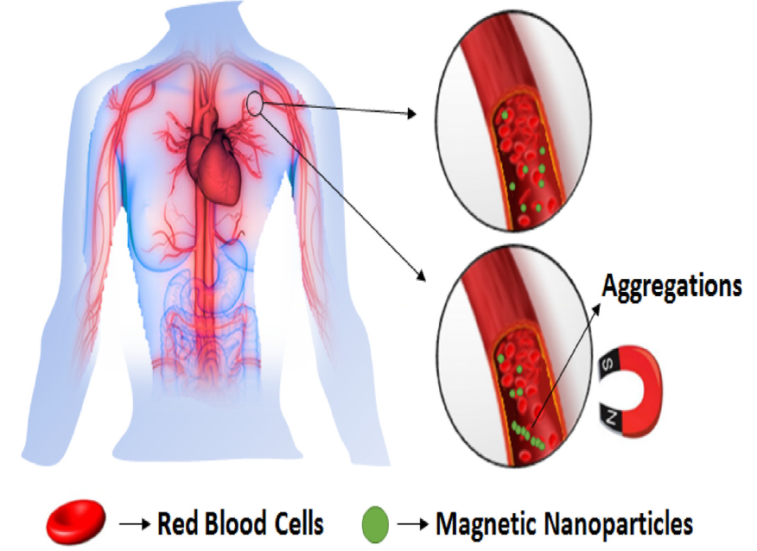
Introduction
Chemotherapy is used for the fight against cancer cells and tumors
Toxic side-effects as the drug attacks both healthy and cancer cells
to reduce the side-effects
Navigation of drug-loaded magnetic particles towards the tumors by using external magnetic fields
High gradient magnetic fields is acquired and Magnetic Resonance Imaging (MRI) may be used.
Minimized side-effects& enhanced therapeutic efficiency
3/21

Slide 4
Introduction
The size of particles
The smaller the particles size, the weaker their magnetic response.
Particle aggregates formed parallel to the magnetic field
More sensitive to gradient magnetic fields easy to drive
Higher magnetic moment
navigated close to the target area
switching off the magnetic field
Aggregations break up to facilitated drug release
The strength magnetic field
Too strong magnetic field result in too large aggregates
Weak magnetic field result in smaller aggregates
Form the clot in small arteries
Smaller magnetic momentum, hard to drive
4/21

Slide 5
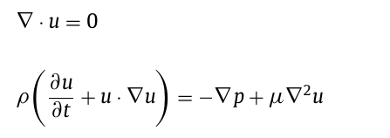
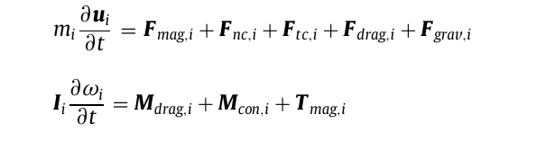
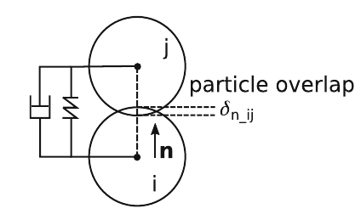
Numerical model
Eulerian phase(fluid) +Lagrangian model(particles)
Euler to DEM.
Laminar incompressible Navier–Stokes equations
Lagrangian particles motion equations(Newton’s law):
DEM
EULER
Brownian forces
Ignored factors
Van der Waals force
Spring& damping model
5/21

Slide 6
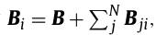
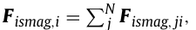
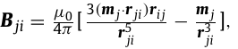
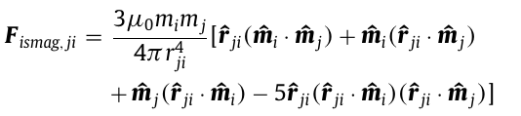
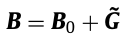
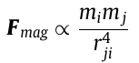
Numerical model
Magnetic field + particle surrounding
The magnetic field acting on the ith particle
Uniform field +gradient field
The interaction distance
Interactions among particles only occurs here
Related with magnetic field and the particle sizes
15di for B0 <0.5T
25di for 0.5T<B0 <0.8T
32di for B0 >0.8T
6/21

Slide 7
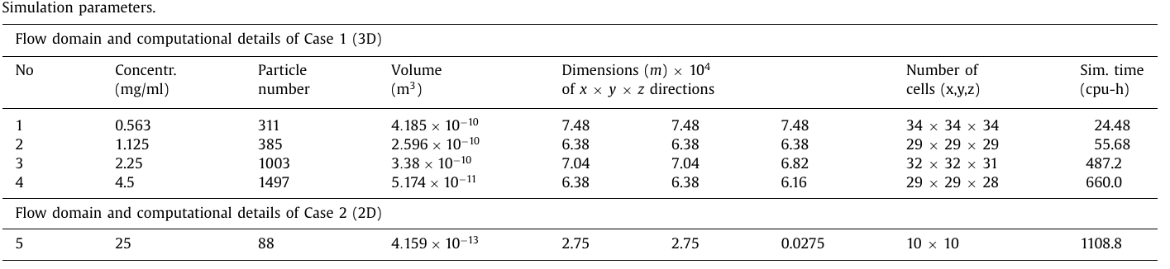
Case description(validation)
Pressure velocity couple method pressure implicit with splitting of operators (PISO) method
Magnetic field for case1
Density of particle& fluid:1087 kg/m³ and 1000 kg/m³
Time step is set to 10⁻⁶ s
Magnetic field for case2
Diameter of particles is 11um and 5.5um for case1 and case2
Young’s modulus of the particle material is 10⁹ N/m²
The magnetic permeability of the fluid is 1.25 × 10⁻⁶ A/m
Tangential stiffness is 10 Nsm⁻¹
The relative magnetic permeability of particles is 1.23
The Poisson ratio& COF. are both 0.5
7/21

Slide 8
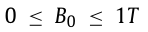
Case description(study on the function of B, G&dp )
Pressure velocity couple method pressure implicit with splitting of operators (PISO) method
Density of particle& fluid:1087 kg/m³ and 1000 kg/m³
Time step is set to 10⁻⁶ s
For const M field:
Diameter of particles is 11um and 5.5um for case1 and case2
The increment is 0.1T
Young’s modulus of the particle material is 10⁹ N/m²
Tangential stiffness is 10 Nsm⁻¹
The Poisson ratio& COF. are both 0.5
For gradient field:
Range from 0~1T/m
The magnetic permeability of the fluid is 1.25 × 10⁻⁶ A/m
B0 are 0.5 and 1T
The relative magnetic permeability of particles is 1.23
The increment is 0.1T/m
Material properties are same as former cases
For particles’ size:
Particles’ size are 11um& 22um for each cases above
8/21

Slide 9
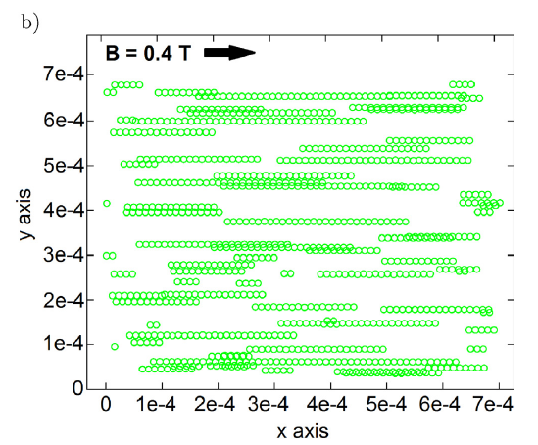
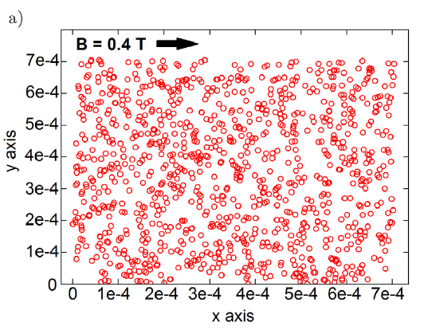
Result& discussion(validation& comparison)
concentration 2.25 mg/ml.
Case1 no.3
Saturated condition
Initial condition
The agglomeration process is found to last for around 5ms for all cases
9/21

Slide 10
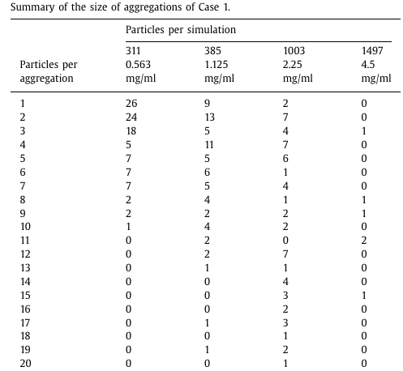
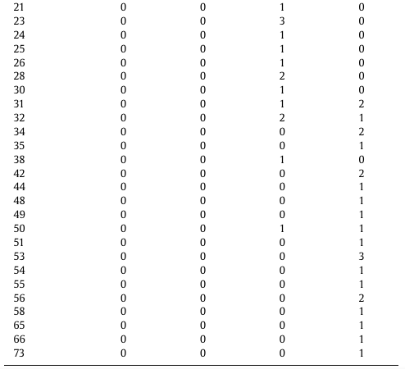
Result& discussion(validation& comparison)
Case1 with only Const. M field
The aggregations’ size are denoted by the number of particles in them
Size increase as concentration increase
10/21

Slide 11
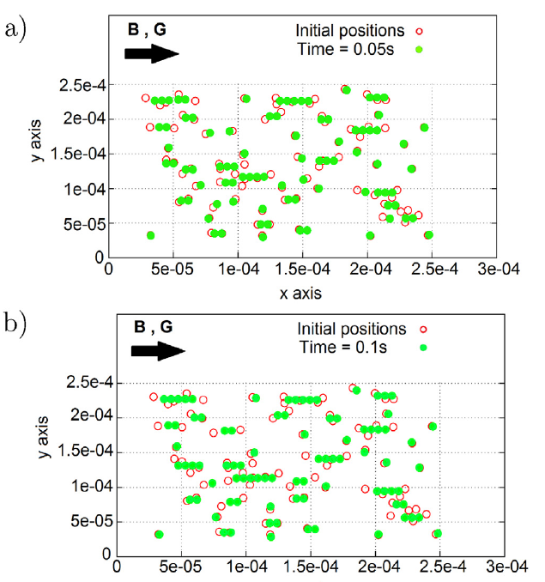
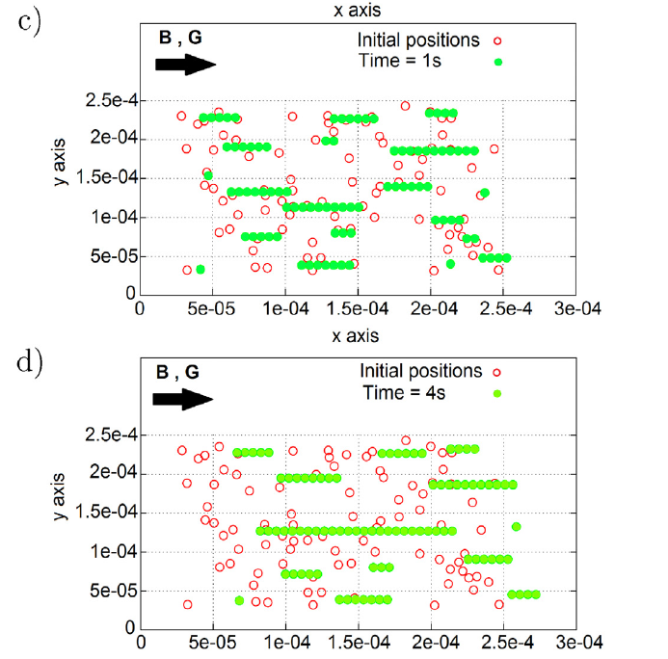
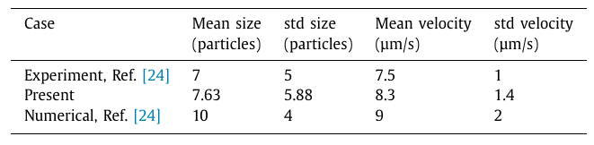
Result& discussion(validation& comparison)
Agg formed by constant M field and driven to move by the gradient M field
The formation of agg phenomenon only last till t=1.25, then only the transportation phenomenon occurs.
The longer time for saturation of the agg formation can be explained by the truth that the constant field is weaker compared with case 1.
Vartholomeos P, Mavroidis C. In silico studies of magnetic microparticle aggregations in fluid environments for MRI-guided drug delivery[J]. IEEE transactions on biomedical engineering, 2012, 59(11): 3028-3038.
11/21

Slide 12
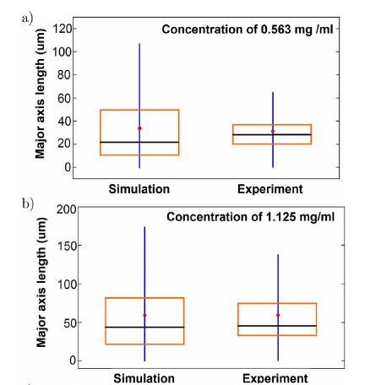
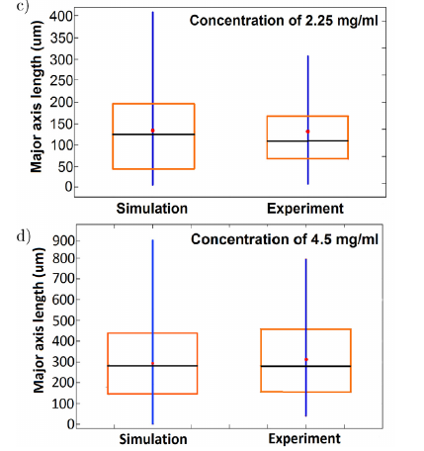
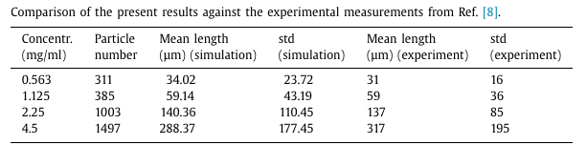
Result& discussion(validation& comparison)
Size increase as concentration increase
Mathieu J B, Martel S. Aggregation of magnetic microparticles in the context of targeted therapies actuated by a magnetic resonance imaging system[J]. Journal of applied physics, 2009, 106(4): 044904.
12/21

Slide 13
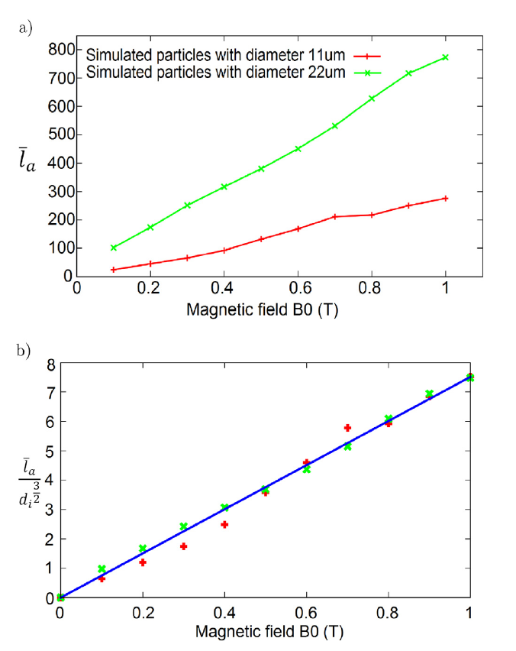
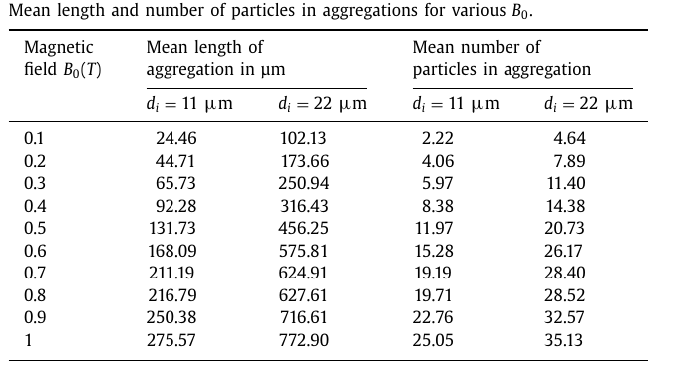
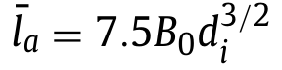
Result& discussion(permanent magnetic field)
The increase of B0 results in increasing the magnetic moment and interaction distance of particles
As a result, more particles are interact each other and form bigger aggregates.
least square fitting
13/21

Slide 14
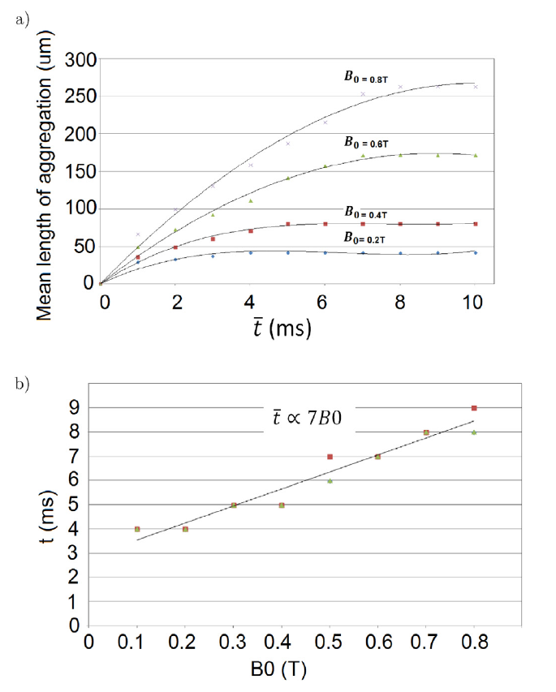
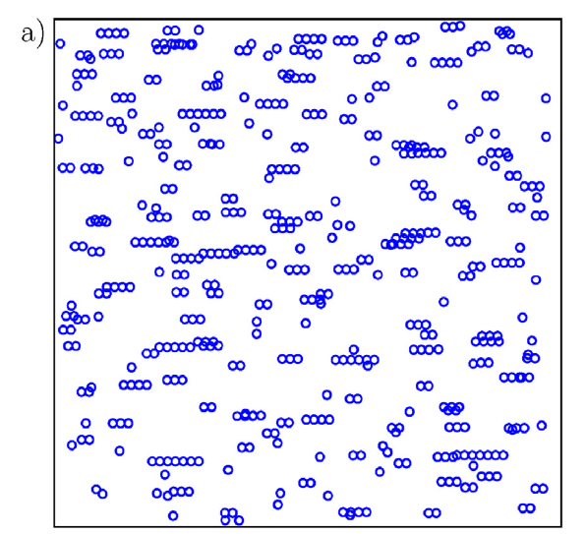
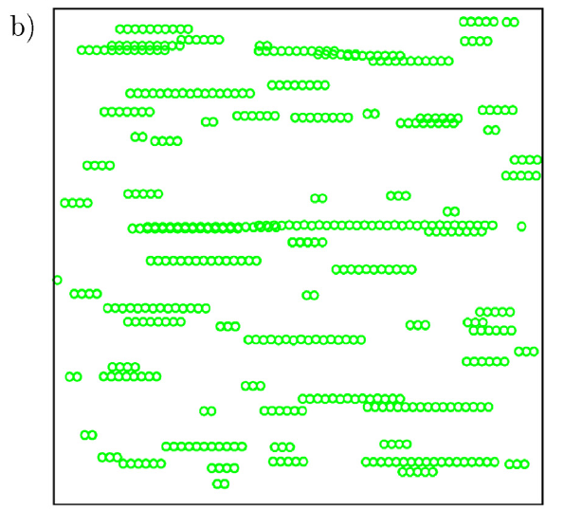
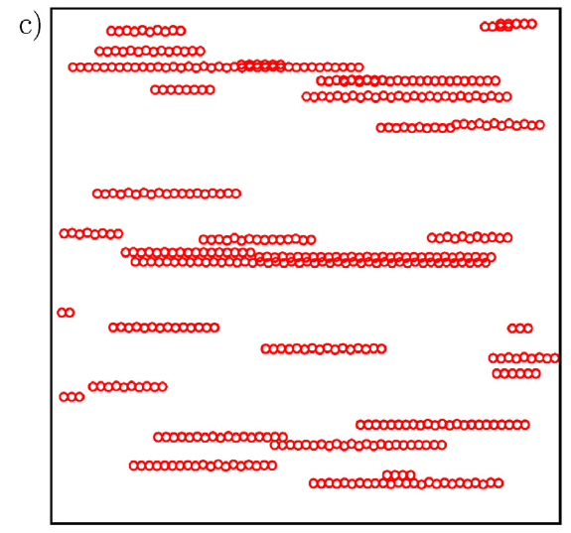
Result& discussion(permanent magnetic field)
The agg saturate sooner for lower B0
This is coherent with the size,the mean length of aggregations in the case of small B0 because chains are shorter due to the reduced magnetic force and interaction distance.
a) 0.1T, b) 0.4 T, and c) 0.7T.
least square fitting
14/21

Slide 15
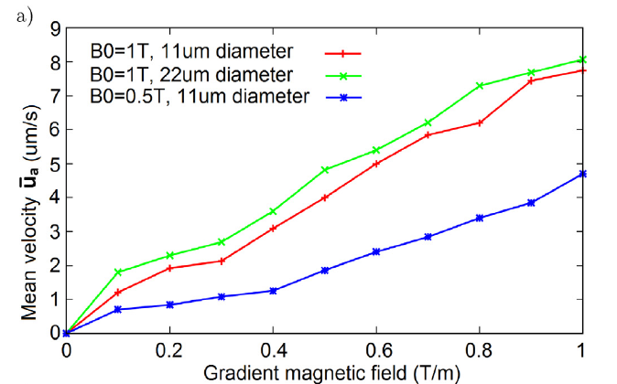
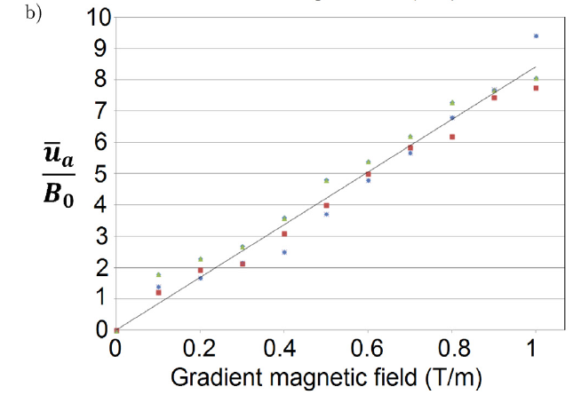
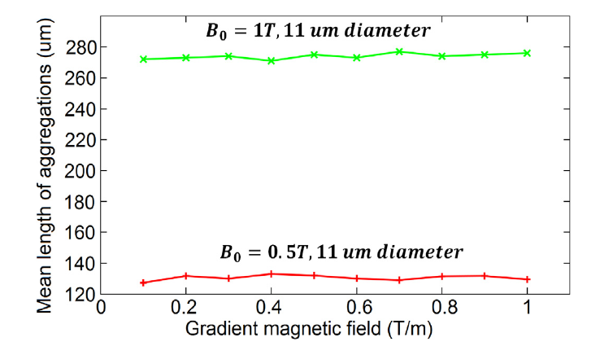
Result& discussion(gradient magnetic field)
As aggregations are formed by the attraction magnetic force due to B0 ,particles are accelerated after a critical length is achieved by the magnetic gradient in the parallel to G direction, until a constant velocity is succeed upon time.
Not linear with G
No influence on agg size and time for it
least-square fitted
15/21

Slide 16
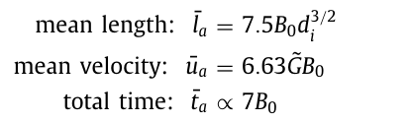
Conclusion& summary
1. A numerical model to predict the motion of magnetic particles for medical applications is developed.
2. This model is found suitable to predict the formation of aggregations and their motion under the action of permanent and gradient magnetic fields, respectively, that are produced by an MRI device.
3. Good agreement is achieved in validation process performed on the contrast with the experiment data.
4. the application of B0 is essential for the efficient motion of particles because the constant magnetic field makes particles to attract each other and to form aggregations, while in the absence of B0 , the magnetic moment of single particles is so weak that is difficult for G to move them.
16/21

Slide 17
Physical description& assumption making
Numerical modeling& equation properties(parabolic, hyperbolic, elliptic equations)
Turbulence modeling ? (laminar, turbulence(Rans Les DNS)) trade-off
Geometry design Boundary& initial condition
Mesh design& quality analysis: skewness; non orthogonality; aspect ratio.
(structural vs. unstructured mesh) . (Dynamic mesh, Overset mesh etc)
Discretization (FVM scheme): AX=B construction
gradient, divergence, diffusion, convection,transient,source.
(central difference, upwind, Least Squares)---problem about precision order
Solver (iteration)
For incompressible simple piso pimple etc.(pressure based couple)
For compressible status equations etc.(density based couple)
Precision : for mesh quality and iteration ---some correction methods
Stability : relaxation factor, time step(courant number)
Post-process: Paraview, Tecplot, Gnuplot, Origin, Python etc.
Qualitative Analysis{animation contour}
Quantitative analysis{plot, node database}
Experiment& reference: validation and verification.
Flow of a CFD simulation
70% of whole time
CFD solvers
17/21

Slide 18
Platform comparison
Commercial platform: Cell based Fluent, Star-ccm; vertex based: CFX etc.
Advantage: 1.Graphic operation interface.
2.Complete help documentation, engineer consultant.
3.Friendly to user.
Shortcoming : 1.Limitation for num of CPU.
2.High budget.
3.Low flexibility (black box):only embedded method are available.
The original code cannot be changed or viewed.
4.The power of UDF sometimes insufficient.
Open source: OpenFOAM(solver with 2nd order precision)
Advantage: 1.Free
2.No limitation for num of CPU (parallel calculation is a trouble).
Usually enhanced by super computer with script.
3.Open source, all the codes are visible and changeable(implantation).
Shortcoming :1.High requirement for user(CFD, linux OS, script, C++).
2.Instability, debug is time consuming.
3.Less tutorials(but the original code is available but need to find and understand).
4.No graphic operation interface, command operation,the interpreter like bash, zsh etc. are needed.
18/21

Slide 19
Reference
[1]
Mathieu J B, Martel S. Aggregation of magnetic microparticles in the context of targeted therapies actuated by a magnetic resonance imaging system[J]. Journal of applied physics, 2009, 106(4): 044904.
[2]
Vartholomeos P, Mavroidis C. In silico studies of magnetic microparticle aggregations in fluid environments for MRI-guided drug delivery[J]. IEEE transactions on biomedical engineering, 2012, 59(11): 3028-3038.
[3]
Pálovics P, Németh M, Rencz M. Investigation and modeling of the magnetic nanoparticle aggregation with a two-phase CFD model[J]. Energies, 2020, 13(18): 4871.
[4]
Pálovics P, Rencz M. Investigation of the motion of magnetic nanoparticles in microfluidics with a micro domain model[J]. Microsystem Technologies, 2020: 1-15.
[5]
Jasak H. Error analysis and estimation for the finite volume method with applications to fluid flows[J]. 1996.

Slide 20
Chengxi Yao| 2nd Semester –Ph.D
Thank you for your attention
★★★★★★★★★★★★★★★★★★★★
★★★★★★★
★★★★★★
★★★★★
★★★★
★★★
★★
★

Slide 21
Weekly Report
Chengxi Yao| 2nd Semester –Ph.D
 | Results | Plans
SPM reaction process simulation (with KH) | -abstract for conference | -experiment
Tangential Flow Filtration Research (with SH, JW) | - | -
-Particle aggregation simulation (SH,WK) | - UDF for lorentz Force (with bug for syntax, pointer) | - test and debug the coding
High performance simulation | -first try on OpenFOAM -C++ & shell learning -Linux OS. -diffusive& convective term discretization | Long term learning -Open Foam -mesh design& evaluation -Machine learning algorithm -C++ & shell -parallel computing with OpenFOAM(nextstage) -reference(paper of Jasak& FVM )
Others | - | -

